Slide 1

DEEP DIVE SERIES
Corticosteroid Use in COVID-19 Respiratory Failure
The role of corticosteroids in severe infections, sepsis, and ARDS has been a constantly evolving discussion and remains controversial. The recent APROCCHSs, ADRENAL and DEXA-ARDS along with other prior data have shown the benefits of corticosteroids for sepsis and ARDS, however their use is not universal.^{1,2,3} The Covid-19 pandemic has further highlighted the need for strong RCTs to guide appropriate management.
This EMRA Critical Care Committee Deep Dive will examine the trials that currently guide corticosteroid use in COVID-19 respiratory failure.
By Taylor Miller, MD; Brian Sumner, MD; Oswald G. Reid, Jr., MD; Sean Hickey, MD
Notes:
The ARDSnet trial, a multicenter randomized control trial, compared traditional ventilation (initial tidal volume of 12mL/kg and plateau pressure <50cm H2O) to lower tidal volume ventilation (initial tidal volume of 6mL/kg and plateau pressure <30cm H2O). The study enrolled 861 patients who were intubated and developed ratios of PaO2/FiO2 <300, bilateral pulmonary infiltrates, and no signs of left atrial hypertension or pulmonary-capillary wedge pressures of 18mm Hg or less (consistent with non-cardiogenic cause of pulmonary infiltrates). The trial was terminated early as the use of lower tidal volumes was associated with decreased mortality and increased ventilator-free days. The mortality rate of patients in the traditional ventilation group was 39.8% compared to 31.0% for patients receiving lower tidal volume ventilation. Additionally, the traditional ventilation group had an average of 12+/-11 ventilator-free days vs 10+/-11 for the lower tidal volume group. However, the authors note that this second primary outcome may be difficult to interpret as there was a similarity of ventilator-free days among survivors of both groups, potentially indicating that the results of this primary outcome were mainly driven by the reduced mortality seen in patients receiving lower tidal volume ventilation. Ultimately, ARDSnet demonstrated that lower tidal volume ventilation, placing a greater priority on lung-protective ventilation than concerns over acidosis or partial pressure of arterial CO2, reduces mortality in patients with acute lung injury and acute respiratory distress syndrome.

Slide 2

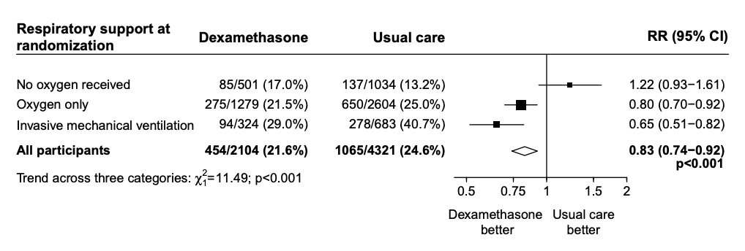
Effect of Dexamethasone in Hospitalized Patients with COVID-19 - Preliminary Report
The RECOVERY Collaborative Group
DEEP DIVE SERIES
Steroids in COVID-19
Objective
To determine the effect of dexamethasone on 28-day mortality in hospitalized patients with COVID-19.
Intervention
Dexamethasone 6 mg daily for 10 days
Compared to usual care
Methods
Open-label
Randomized, controlled trial
176 NHS hospitals in the United Kingdom
  Primary Outcome: 28-day all-cause mortality
Patients who received dexamethasone had significantly lower 28-day mortality (21.6% vs 24.6%, RR 0.83, 95% CI: 0.74-0.92).
  Figure: Relative mortality risk by oxygen requirement:
The Bottom Line
This was the first study to identify that steroids decrease mortality in COVID-19 patients. The mortality reduction is large, with a number needed to treat to prevent one death of 8 patients receiving mechanical ventilation and 25 patients requiring oxygen. There was, however, a nonsignificant signal of harm in patients who didn’t require oxygen support, which suggests it should not be used indiscriminately.

Slide 3
Effect of Hydrocortisone on Mortality and Organ Support in Patients With Severe COVID-19. The REMAP-CAP COVID-19 Corticosteroid Domain Randomized Clinical Trial
The Writing Committee for the REMAP-CAP Investigators
DEEP DIVE SERIES
Steroids in COVID-19
Objective
Study investigators aimed to determine whether hydrocortisone improved outcomes for patients with severe COVID-19.
Intervention
Randomized to one of three dosing regimens within the domain of hydrocortisone therapy.
7-day course of intravenous hydrocortisone (50 mg or 100 mg every 6 hours)
Shock-dependent course (50 mg every 6 hours when shock was clinically evident)
No hydrocortisone
Methods
Multicenter, Randomized, embedded, multifactorial, adaptive, platform trial
Statistical analysis with Bayesian statistics
  Primary Outcome: Days alive and free of ICU-based cardiopulmonary support within 21 days of randomization
Median organ support–free days were 0 (IQR, –1 to 15), 0 (IQR, –1 to 13), and 0 (IQR, –1 to 11)
  Value of (-1) was used as the outcome for death
Median adjusted odds ratios of 1.43 (95% CrI, 0.91-2.27) and 1.22 (95% CrI, 0.76-1.94) for the fixed-dose and shock-dependent groups
  Associated with a 93% and 80% probability of superiority when compared to no hydrocortisone therapy
Selected secondary outcome:
Median adjusted odds ratios of 1.03 (95% CrI, 0.53-1.95) and 1.10 (95% CrI, 0.58-2.11) for the fixed-dose and shock-dependent groups, respectively → associated with a 54% and 62% probability of superiority when compared to no hydrocortisone administration
The Bottom Line
Study authors demonstrated the high probability of superiority of corticosteroid use compared to no steroids with respect to organ support free days within the first 21 days of treatment in patients suffering from COVID-19 and requiring cardiopulmonary support in an ICU. Of note, this study was stopped early and didn’t make their prespecified targets for significance.

Slide 4
Effect of Hydrocortisone on 21-Day Mortality or Respiratory Support Among Critically Ill Patients with COVID-19
The CAPE COVID Trial Group Investigators
DEEP DIVE SERIES
Steroids in COVID-19
Objective
Study investigators aimed to determine whether hydrocortisone impacts treatment failure on day 21 in critically ill patients with severe acute respiratory syndrome coronavirus 2 (SARS-CoV-2) infection and acute respiratory failure (ARF).
Intervention
  Patients were randomized to one of two dosing regimens:
14-day course of hydrocortisone 200 mg/d until day 7, 100 mg/d for 4 days, and 50 mg/d for 3 days.
Placebo: Saline
Methods
Multicenter, randomized, double-blind, sequential trial with interim analyses planned for every 50 patients.
Embedded in the ongoing Community Acquired Pneumonia: Evaluation of Corticosteroids (CAPE COD) trial.
For the primary analysis, missing data was considered treatment failure. No imputation was made for secondary outcomes. The statistical tests performed for this study were 2-sided.
  Primary Outcome: Treatment failure on day 21 (Death or persistent dependence of mechanical ventilation or high-flow oxygen therapy)
Secondary Outcome: Hydrocortisone group vs. Placebo group
Need for endotracheal intubation (for patients non invasively ventilated at inclusion): 8/16 (50.0%) v. 12/16 (75.0%)
Cumulative incidences of prone position sessions: 36 (47.4%) vs. 39 (57.4%)
Need for extracorporeal membrane oxygenation: 2 (2.7%) vs/ 2 (2.7%)
Need for Inhaled nitric oxide: 5 (6.7%) vs. 11 (15.0%)
Occurrence of nosocomial infections on day 28: 28 (37.7%) vs. 30 (41.1%)
Hydrocortisone (n=76) | 32 | 42.1%
Placebo (n=73) | 37 | 50.7%
The Bottom Line
The use of low-dose hydrocortisone in critically ill patients with COVID-19 and ARF did not significantly reduce the prevalence of treatment failure at day 21. It is important to note that this clinical trial was stopped early, which may have impacted its ability to provide a statistical difference in the primary outcome.

Slide 5
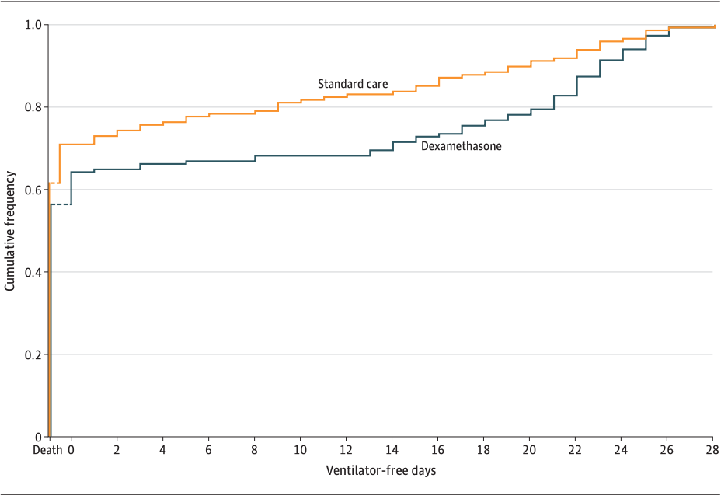
Effect of Dexamethasone on Days Alive and Ventilator-Free in Patients with Moderate or Severe Acute Respiratory Distress Syndrome and COVID-19: the CoDEX Randomized Clinical Trial
The COALITION COVID-19 Brazil III Investigators
DEEP DIVE SERIES
Steroids in COVID-19
Objective
To identify the effect of dexamethasone on ventilator free days in patients with COVID-19 associated ARDS
Intervention
Dexamethasone 20 mg IV once daily for 5 days, then 10 mg IV for 5 days or until ICU discharge
Compared to standard care
Methods
Open-label
Randomized, controlled trial
41 ICUs in Brazil
  Primary Outcome: Ventilator free days in the first 28 days, defined as days alive and free of mechanical ventilation for at least 48 hours
Days alive and free of a ventilator in 28 days was 6.6 days in the dexamethasone group and 4.0 days in the control group, for an adjusted difference of 2.26 days (95% CI: 0.2-4.38, P= 0.04).
There was no difference in secondary outcomes or adverse events
Figure: Ventilator-free days at 28 days
The Bottom Line
The administration of steroids increased ventilator-free days for this particularly sick cohort of COVID-related ARDS patients.

Slide 6
Association Between Administration of Systemic Corticosteroids and Mortality Among Critically Ill Patients With COVID-19: A Meta-Analysis
The WHO Rapid Evidence Appraisal for COVID-19 Therapies (REACT) Working Group
DEEP DIVE SERIES
Steroids in COVID-19
Objective
Study investigators aimed to determine if the administration of systemic corticosteroids was associated with reduced 28-day mortality in critically ill patients with coronavirus disease 2019 (COVID-19).
Methods
Meta-analysis of 7 clinical trials which examined the clinical effects and outcomes of corticosteroids administration in patients with COVID-19
DEXA-COVID
CoDEX
RECOVERY
CAPE COVID
  Inclusion Criteria
Listed with clinicaltrials.gov, Chinese Clinical Trial Registry or EU Clinical Trials Registrar
Listed between December 31, 2019 and Apri 6, 2020
Trials must have examined interaction of corticosteroids and COVID-19
  Exclusion Criteria:
Wrong intervention
Not currently enrolling
Ineligible Population
  Primary Outcome: All-cause mortality up to 30 days after randomization (shorter terms accepted if 30 days not available)
Number of deaths in patients receiving corticosteroids | 222/678
Number of deaths in patients receiving usual care or placebo | 435/1025
Summary OR for death in patients receiving dexamethasone | 0.64 (95% CI, 0.50-0.82; P < .001)
Summary OR for death in patients receiving hydrocortisone | 0.69 (95% CI, 0.43-1.12; P = .13)
OR for death in patients receiving methylprednisolone | 0.91 (95% CI, 0.29-2.87; P = .87)
COVID STEROID
REMAP-CAP
Steroids-SARI
The Bottom Line
Use of corticosteroids in critically ill patients, including those with COVID-19 was shown to be associated with lower 28-day all-cause mortality. The lack of synthesis of this data into recommendations of dosage and duration of treatment makes these findings less user-friendly, but point towards overall mortality benefits.

