Slide 1
Introduction to Health Advocacy and Resources
Sarah Hoper MD,JD
EMRA Legislative Advisor

Slide 2

What is Advocacy?
Advocacy is political activity with the goal of creating change.
  Based on the power of people to take collective action on their own behalf
  Federal, state, and local level

Slide 3
Advocacy
Physician’s public role: advocacy for and participation in improving the aspects of communities that affect the health of individuals.
Gruen RL, Pearson SD, Brennan TA. Physician-Citizens – Public Roles and Professional Obligations.
JAMA. 291: 94-98. 2004.
Notes:
Not just about advocacy at the bedside – need to be thinking and working on a broader basis on the previously mentioned issues – improving insurance coverage, community resources, availability of specialty referral
And our patients need more than just medical care to improve their health – they need food, homes, safety

Slide 4
Why Should We Advocate?
Our Patients….
  Medicaid Expansion
  State Health Insurance Exchanges
Ourselves….
  Medical Liability
  GME Funding
Notes:
There are two major reason to advocate…
Our patients and our selves
Today specifically we are going to look at Medicaid Expansion, Insurance Exchanges, Medical liability and GME funding.

Slide 5
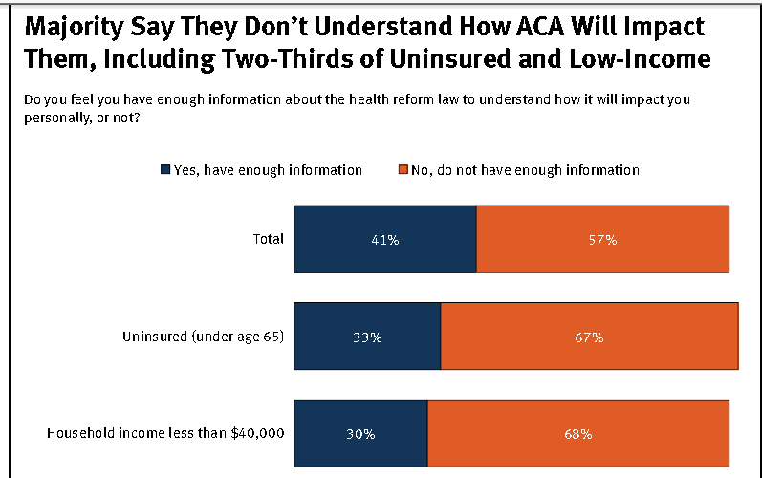
Public Awareness of ACA
http://www.kff.org/kaiserpolls/upload/8425-C.pdf
Notes:
A recent Kaiser Family Foundation poll of 200 people across all ages, races and educational backgrounds showed most Americans don’t understand the ACA either. And 2/3’s of those uninusred and low income individuals who have the most to gain from the law.

Slide 6




Public Awareness of ACA
Enroll America survey found:
  83% of those eligible for Medicaid are unaware they will qualify for the program
  78% of those eligible for tax credits to buy insurance through the exchanges are not aware of their eligibility.
Available at: http://www.enrollamerica.org/categories/population-specific

Slide 7
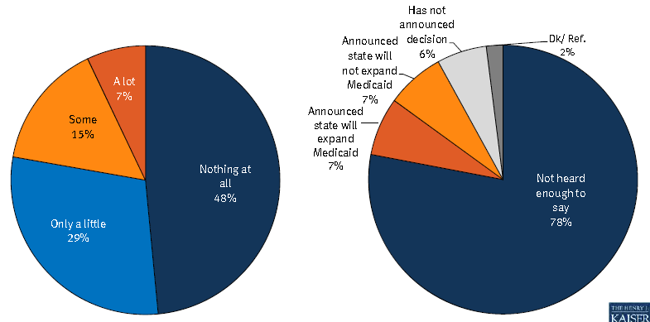
Public Awareness of ACA
Health Exchanges
Medicaid Expansion
Notes:
And when asked if their states have made in decisions regard Health exchanges 48% people know nothing at all about and 30% ask%they little bit. In regards Medicaid Expansion 78 say they are not aware that their state has made a decision to expand or to not expand

Slide 8

Medicaid Expansion
ACA expands the number of people the states must cover
Any one 64 and younger with income up to 133% of the federal poverty level will be covered by Medicaid
Notes:
Each state as its own sets of “disregards” for income and assets.

Slide 9
Medicaid Expansion
133% of Federal Poverty level:
  Family of 1: $14, 856
  Family of 2: $20, 123
  Family of 3: $25, 390
  Family of 4: $30, 657
  Family of 5: $35, 923
  Family of 6: $41,190

Slide 10
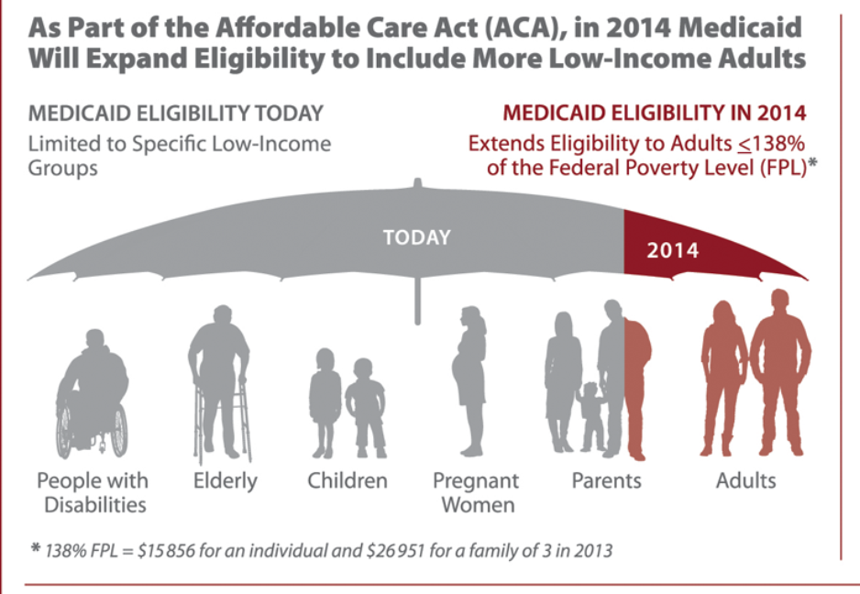
JAMA. 2013;309(12):1219-1219. doi:10.1001/jama.2013.2481
http://www.kff.org/medicaid/jama_infographic_0313.cfm
Notes:
Current Medicaid covers: the disabled, the elderly, children, Pregnant women and Needy families - unemployed parents who make less then 37% of federal poverty, Employed parents who make less then 63% of federal poverty.

Slide 11

Medicaid Expansion
  Federal Gov’t will pay 100% of the costs of new patients until 2016
  In the following years the federal payment will gradually decrease to a minimum of 90% in 2020
  Medicaid spending will increase by $100 billion/year
    40% increase

Slide 12
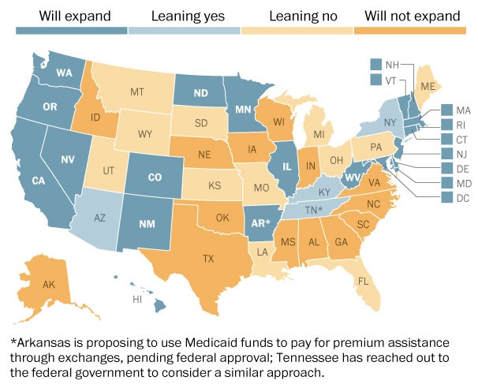
Notes:
Nationally, 24 states have expressed a desire to expand Medicaid. 26 states said they will reject it

Slide 13
Alternatives to Medicaid Expansion
Missouri HB 700 –
  Expand Medicaid eligibility up to 100% of the federal poverty line
  This leaves out 80K Missourians who earn b/w 100-138%
Notes:
HB 700 is authored by Jay Barnes

Slide 14

Alternatives to Medicaid Expansion
The Arkansas Plan –
  Use the federal funds to buy private health insurance for the 200,000 people who would have been covered under the expansion
  HHS Secretary Kathleen Sebelius has agreed to this proposal

Slide 15
Alternatives to Medicaid Expansion -Arkansas
Florida, Ohio, Louisiana, Maine, Oklahoma, Tennessee and Pennsylvania are considering this option

Slide 16
Alternatives to Medicaid Expansion - Arkansas
Downside:
  The CBO estimates it will cost $9,000 per person to buy private insurance compared to $6,000 to add a person to Medicaid
  because private insurers pay hospitals and doctors more then Medicaid does

Slide 17
Advocacy Points
Medicaid expansion will improve the healthcare of millions of people
  How will the system care manage the influx of patients
States that have chosen not to expand will loose out and billions of dollars of federal money
  But will the money be there as promised in future years
Will Patients flux from one to state to another to get benefits?
The House Voted for the 37th time to totally repeal the ACA last week

Slide 18
Advocacy Resources - ACA
HealthCare. Gov
  Government’s website on the ACA
  http://www.healthcare.gov/law/

Slide 19

Health Insurance Exchange
Small employers (≤100 employees) and individuals will qualify for the exchange
Large companies can use the exchanges for pre-Medicare retirees and part-time employees.

Slide 20
Health Insurance Exchange
Insurers cannot refuse to insure any individual.
The plans cannot have lifetime and annual limits.
There will be four plans:
  Bronze - will cover 60% of medical costs
  Silver – will cover 70% of medical costs
  Gold – will cover 80% of medical costs
  Platinum- will cover 90% of medical costs

Slide 21
Health Insurance Exchange
  Each of the plans will be limited to out-of-pocket expenses of:
    $5,950 for individuals
    $11,900 for families

Slide 22
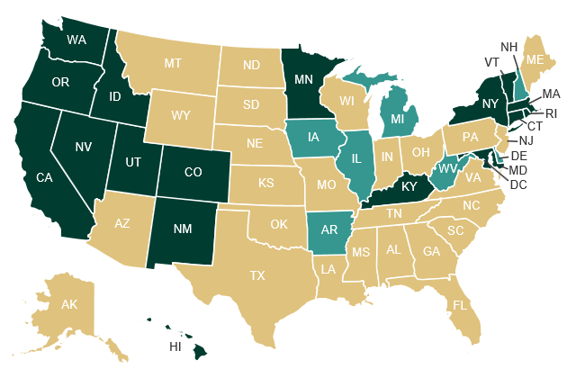
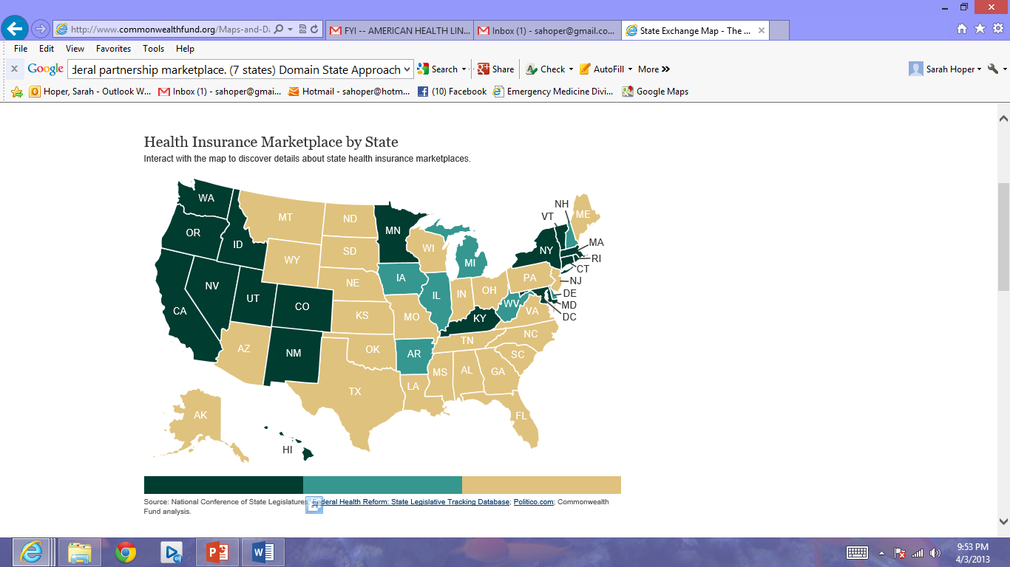
Health Insurance Exchange
State Run Partnership Federally Run
Notes:
Two-thirds of U.S. residents who obtain coverage through an exchange under the ACA will do so in either a federally run exchange or a partnership exchange. Potentially, there could be a small number of insurance companies that win contracts with the government to provide insurance to a majority of the population. If you want take this a step further, you could theorize that it is possible in the future there are only 1 or 2 insurance companies winning government contracts which puts us very close to a single payer option for folks participating in an insurance exchange. Although this is not the traditional single payer option, of having the government as the single payer it is interesting to think about.

Slide 23
Health Insurance Exchange
Congress estimates 22 million people will be insured through the exchanges
  1 million will be high-risk individuals with pre-existing conditions
Rep. Henry A. Waxman; Rep Bart Stupak (October 12, 2012). “Re: Coverage Denials for Pre-Existing Conditions in the Individual Health Insurance Market.” U.S. House of Representatives Committee on Energy and Commerce. Available @ democrats.energycommerce.house.gov/Press_11/20101012/Memo.Pre-existing.Condition.Denials.Individual.Market.2010.10.12pdf
Pauly MV, Herring B. “Risk Pooling and Regulation: Policy and Reality in Today’s Individual Health Insurance Market.” Health Affairs. 2007; 26 (3): 770-779.
Roby DH. “Private Health Insurance Under Health Care Reform and Health Benefit Exchanges.”

Slide 24
Health Insurance Exchange
In 2017, states can expand their exchanges to include employers with more than 100 employees.
  RAND report estimated 35 million employees will be covered by exchange
  Congressional Budget Office projects 5 million employees
Eibner C, Girosi F, Price CC, Cordova A, Hussey PS, Beckman A et al. Establishing state health insurance exchanges: implications for health insurance enrollment, spending, and small businesses. Santa Monica (CA): RAND Corporation; 2010 Available at http://www.rand.org/content/dam/rand/pubs/technical_reports/2010/RAND_927.pdf
Congressional budget Office. Letter to the Hon Nancy Pelosi. Washington (DC): CBO; 2010 March 20. p.9. Available at: http://www.cbo.gov/ftpdocs/113xx/doc11379/AmendReconProp.pdf

Slide 25

Health Insurance Exchange
Tax Credits 2014
  Available for those with income between 133% and 400% of the poverty line who are not eligible for other affordable coverage.
    In 2010, 400% of the poverty line comes out to about $43,000 for an individual or $88,000 for a family of four.

Slide 26
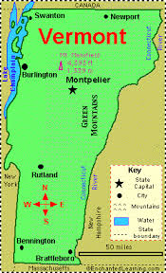
Vermont Exchange Rates
Rates range from:
  average high of $1,700 a month for a family
  average of $745 for catastrophic coverage, only available to people under age 30
http://www.dfr.vermont.gov/sites/default/files/Filed%20QHP%20rates.pdf
http://bostonglobe.com/metro/2013/04/01/first-state-post-health-insurance-rates/GxJWkuKWHoRVy6uJYXNczK/story.html

Slide 27

Vermont Exchange Rates
With the tax credit:
  Family of four with an annual income of $32,000 would end up paying $45 a month out of pocket.
  Single person with a $40,000 income would pay $317 a month

Slide 28
Health Insurance Exchanges - Downside
People moving from catastrophic plans to fully insured products will pay more
Society of Actuaries showed insurers would pay an average of 32% more per claims on individual polices due to the inability to turn away pre-existing conditions
  Bais?-Society of Actuaries and the Health Insurance Companies closely related
  http://thehill.com/blogs/healthwatch/health-reform-implementation.290603-white-house-on-defense-after-sebelius-remark-on-health-law

Slide 29
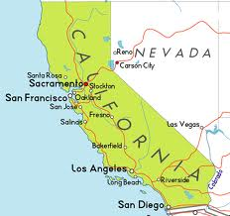
Health Insurance Exchanges - Downsides
In California:
  People with incomes > 400% of the FPL that are not covered by an employer and are using health exchanges may have an increase of 30% in their premiums and 20% in the total cost of health care
  However, those with incomes < 400% of the FPL are in line to save 84% on their premiums and 76% on the total cost of health care
http://www.latimes.com/business/money/la-fi-mo-calif-health-insurance-premium-rates-20130328,0,4950624.story

Slide 30
Health Insurance Exchanges - Downsides
California -
  People under 25 will have a 25% increase in premiums
  Increases are due to guaranteed coverage of all applicants – including sick patients that were previously denied

Slide 31

Downsides – Insurance Loop Hole
ACA allows insurers to extend existing coverage through the end of 2014 without following the new rules
Insurers might rush to enroll more people in individual policies before December so that they then can extend those policies through next year.

Slide 32
Advocacy Points
Patients need to know they are eligible for the exchanges and how to access the exchanges
Patients need to know if they qualify for the tax credit
Different states will have different insurance benefits
FUNDING!!!!!

Slide 33
Advocacy Resources - ACA
Enroll America
  http://www.enrollamerica.org/

Slide 34
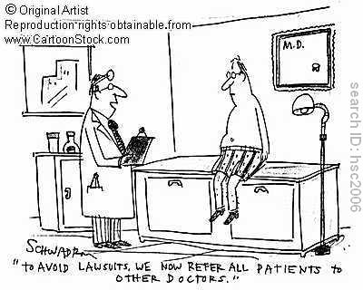
Notes:
Medical Liability will effect every physician’s career. It is important for physicians to understand the facts of medical liability and how to protect themselves.

Slide 35

HR 36 – Health Care Safety Net Enhancement Act of 2013
Emergency Medicine’s Shortcut Around Medical Liability
EMTALA care would be covered under Public Health Service ACT
United States. Cong. House. Health Care Safety Net Enhancement Act of 2013. 113th Cong., 1st sess. @ http://thomas.loc.gov/cgi-bin/bdquery/z?d113:H.R.36:
Notes:
The goal of the bill is to offer increased protection to any provider who is performing care under EMTLA for the first 24 hours. It is the same protection that is afford to the public health corps. The idea is to limit the litigation that may be brought forth by EMTLA related care. This would include us and our consultants.
This only addresses liability – not payment – but it is a step in the right direction. It will take a lot of baby steps until all the flaws are fixed. As a group we need to embrace this first step.
Health Care Safety Net Enhancement Act of 2011 - Amends the Public Health Service Act to deem a hospital or an emergency department and a physician or physician group of such hospital or emergency department to be an employee of the Public Health Service for purposes of any civil action that may arise due to providing emergency and post-stabilization services on or after January 1, 2012. (http://www.govtrack.us/congress/bill.xpd?bill=h112-157&tab=summary)

Slide 36
EMTALA
Emergency Medical Treatment and Active Labor Act
  Enacted in 1986 to stop Patient Dumping
All patients must receive a medical screening examination and stabilization prior to transfer
Physicians working in an Emergency Department cannot choose who they treat
Emtala
"Overview EMTALA." Centers for Medicare & Medicaid Services. Web. 17 Aug. 2011. <http://www.cms.gov/emtala/>.
Notes:
EMTALA = Emergency Medical Treatment and Active Labor Act
A federal law created in 1986. Its rational was appropriate. Before, when a patient presented to an ED if they did not have the appropriate insurance, they would be shipped to another ED that did accept their insurance. This was unfortunate, as it lead to a delay in care and service to the patient. On one occasion, a patient had a negative outcome and Congress stepped in to ensure that all patients, regardless of their ability to pay, could present to an ED and at least obtain a medical screening exam, and if an emergency was identified the patient could be stabilized.

Slide 37

EMTALA Flaw
Service ≠ Payment
Service = Liability
Notes:
Unfortunately the law did not address how the care would be funded.
For many years, when the majority of the patients had insurance, this was a mute point since the hospitals and EDs were able to offset the patients who were unable to pay with the profits obtained by those that were able to.
However, as time has gone on, the ratio of insured to uninsured has shrunk. In addition, reimbursements have decreased. These combination of events has placed a significant cost burden on the hospitals. In some cases, it is causing hospital closures, leading to a loss of the safety nets.
In addition, while EMTALA requires providers to perform emergency stabilization, it offers no protection for liability. The patients presenting for EMTLA related care can be critically ill and therefore more prone to negative outcomes. Additionally, providers often have little or no background information about the patients. This means that emergency care providers are serving a much higher-risk population with less knowledge about the patient, but are equally liable for the care they are providing as someone who knows the patient well and is seeing them in a non-urgent situation.

Slide 38

Specialist Coverage
2/3 EDs - inadequate on-call specialist coverage
  Not being paid
  Sicker population = ↑Bad Outcome
  Same Liability
Vanlandingham B. On-call Specialist Coverage in U.S. Emergency Departments. Irving, TX: American College of Emergency Physicians; 2004
Notes:
While many EM providers continue to accept the uncompensated care with liability, many of our specialist colleagues do not.
A survey of ED directors in 2004 indicated that 2/3 of the EDs had inadequate on-call specialist coverage.
This should not come as a surprise since we are asking our colleagues to come in during the middle of the night, see the sickest of the sick who have a higher chance of having bad outcomes, not get paid, and take on the liability of this care. In addition many of our colleagues are now measured on their outcomes and adverse ones may impact their ratings relating to licensure, compensation, and just overall image.

Slide 39
HR 36 – Health Care Safety Net Enhancement Act of 2013
Public Health Service Act
  Health Care practitioners shall be deemed federal employees for the purposes of medical malpractice liability
  Except for gross negligence, physicians cannot be sued
  BUT United States government may be liable under the Federal Tort Claims Act
Notes:
Other doctors covered by the Public Health Sevice Act include doctors working at federally funded clinics and Indian Health Services

Slide 40
HR 36 -
HR 36 has passed the House 13 times
The bill has NEVER passed Congress
BUT…
  Sen. Roy Blunt brought the bill to the Congressional Floor Last week
Notes:
During our Hill visits will we be trying to recruit co-sponsors for the bill in the House and the Senate

Slide 41

GME Funding
Proposed GME cuts :
  Simpson-Bowles Commission: 60 percent/$60 billion
  Obama 2014 Fiscal Budget: 10 percent/$11 billion
  Others 20 percent/$20 billion

Slide 42
GME Funding
10% reduction – cut 4,098 residents
33% reduction – cut 13,662 residents
50% reduction - cut 22,411 residents

Slide 43
GME Funding
The current physician shortage will exceed 130,000 doctors by 2025 (in all specialties).
The Medicare population will grow by 36 percent over the next 10 years.
One in three physicians is expected to retire in the next 10 years.

Slide 44
Alternate GME Funding
Residents pay tuition
Industry sponsored residency training
More Residency Positions that area paid for by Foreign Countries

Slide 45

GME Funding
The Association of American Medical Colleges

Slide 46
Advocacy Resources - GME
AAMC – GME Funding:
  https://www.aamc.org/advocacy/

Slide 47
Advocacy Resources
Kaiser Family Foundation
  http://kff.org/
  http://www.kaiserhealthnews.org/

Slide 48
Advocacy Resources
Washington Post Wonk Blog Health Policy
  http://www.washingtonpost.com/blogs/wonkblog/wp/tag/health-care/

Slide 49
Advocacy Resources
Politico Health Policy
  http://www.politico.com/healthcare/

Slide 50
Advocacy Resources
The Hill Health Watch Blog
  http://thehill.com/blogs/healthwatch/health-reform-implementation/300037-overnight-health

Slide 51
Advocacy Resources – List Serves
ACEP 911
  A weekly e-mail on Monday's while the House and Senate are in session detailing current health policy activity in Washington
  Sign Up
    http://www.acep.org/Content.aspx?ekfrm=40334

Slide 52
Advocacy Resources – List Serves
Health Leaders Media
  http://www.healthleadersmedia.com/

Slide 53
Advocacy Resources- List Serve
The Huddle- Politico
  A Play by Play Preview of the Day’s Congressional News
  http://www.politico.com/huddle/
  More then just Healthcare

Slide 54
Advocacy Resources – List Serves
National Journal
  http://www.nationaljournal.com/n2ksignup

Slide 55
Advocacy Resources – List Serves
American Health Line
  http://www.americanhealthline.com/
  Not Free

Slide 56
Advocacy Resources
EMRA Health Policy Committee Facebook Page
  https://www.facebook.com/EMRA.Health.Policy
EMRA Twitter Account
  @EM Advocacy

Slide 57
Advocacy Resources
ACEP StateScan
  http://www.acep.org/StateScan/

Slide 58
Advocacy Resources
Open Secrets. Org
  http://www.opensecrets.org/lobby/

Slide 60


